Slide 1
Battery Management System (BMS)

Slide 2
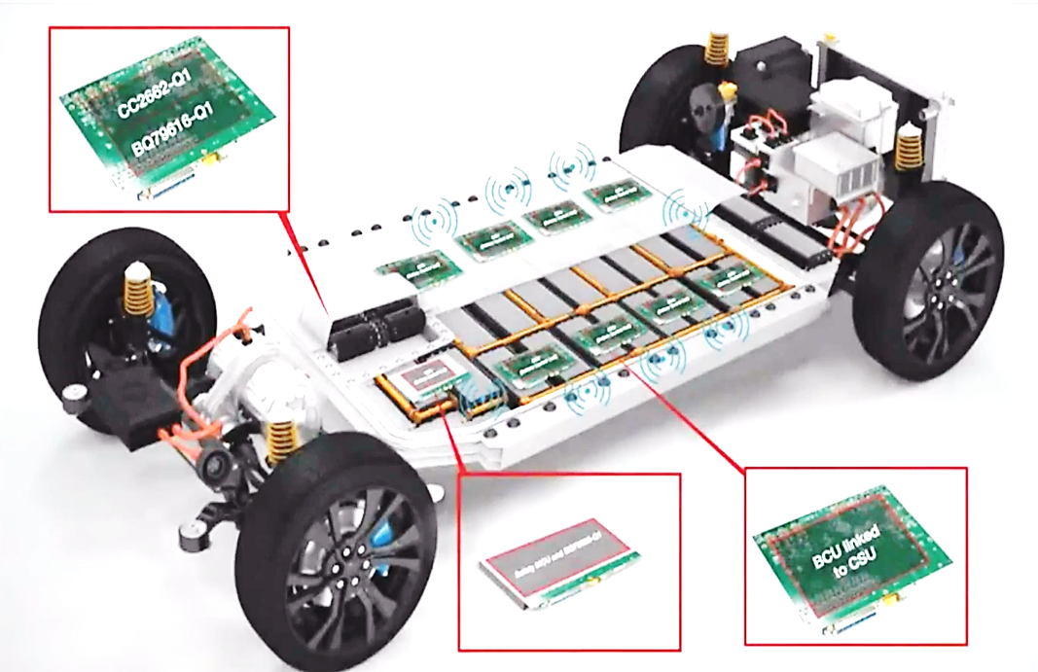

Slide 3
Batteries must be managed properly by electronics:
To protect the application user
Protect the battery pack itself
Maximize the performance (power and energy) delivered by the battery
Maximize the service life of the battery pack itself

Slide 4
Wheel
Accelerator/
pedal
Electronic
Control Unit
Power
Converter
Motor
Mechanical
Drive
Air-
conditioning
Sensing,
Communication
Onboard
Infotainment
Etc.
Battery
Wheel
Battery
Management
System

